Slide 1

Denoising Pile-Up events
13/06/2024
Luke Johnson

Slide 2
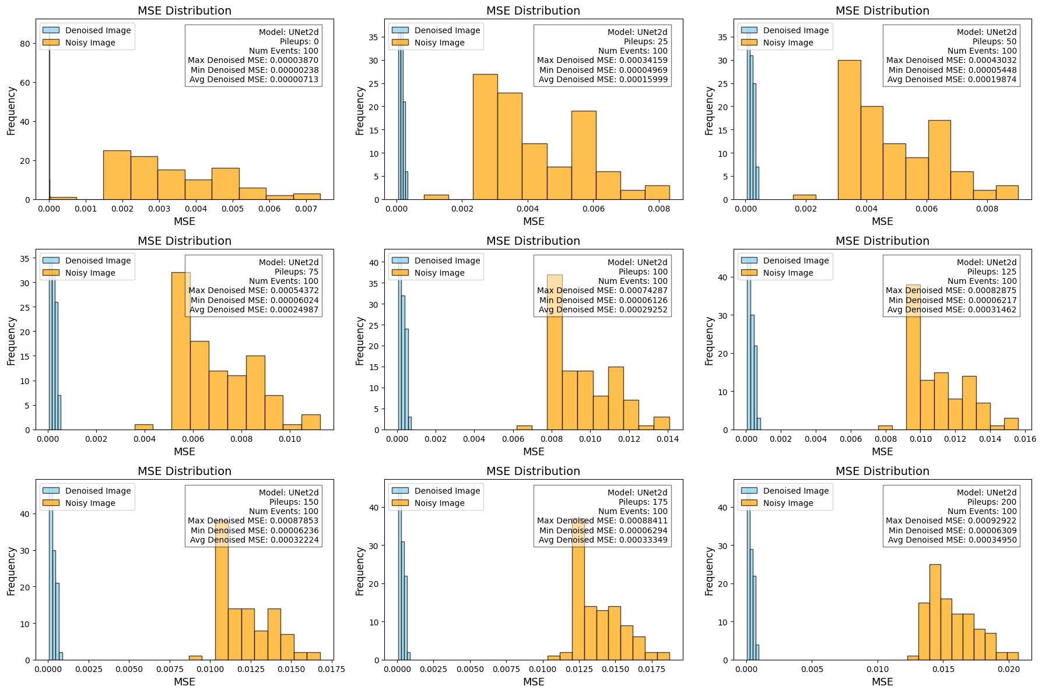
Added some noise to image → removed it with model
Repeated 100 times for various amounts of noise
Yellow = difference between noisy and clean images
Blue = difference between denoised and clean images

Slide 3
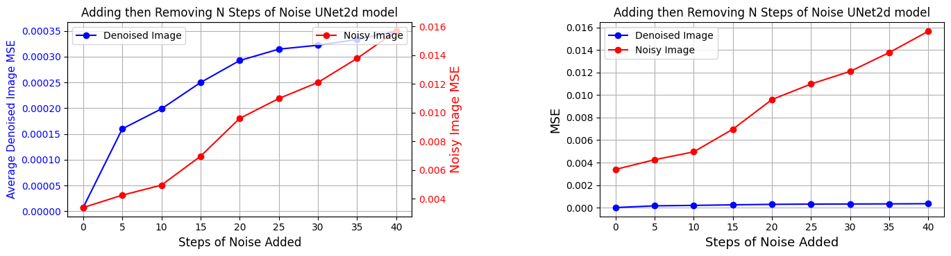
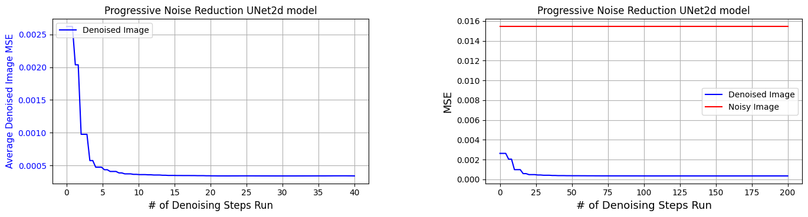

Slide 4
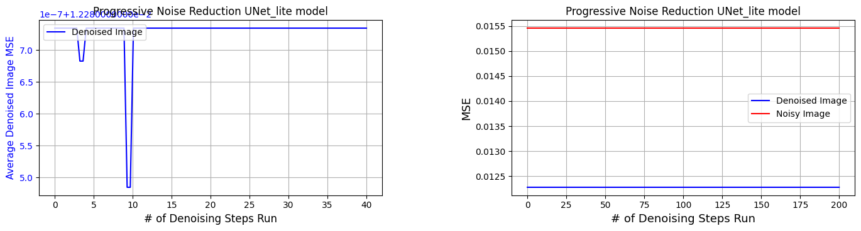
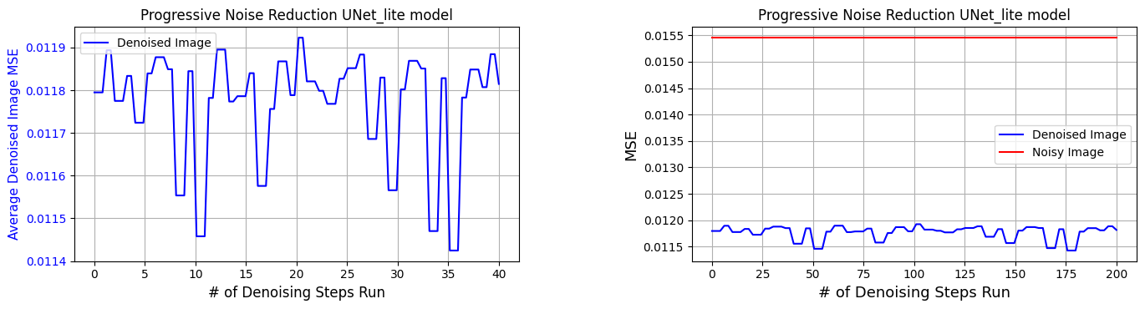
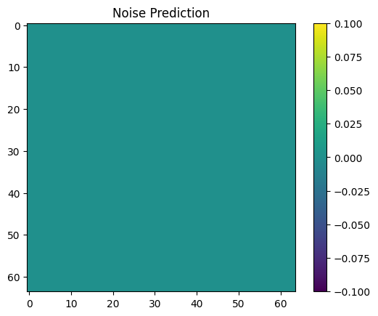
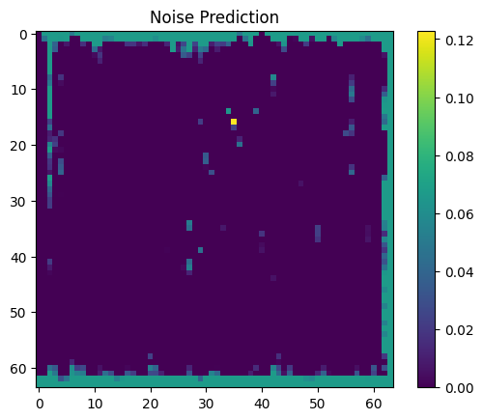

Slide 5

Denoising Pile-Up With Stable Diffusion Week 2
20/06/2024
Luke Johnson

Slide 6
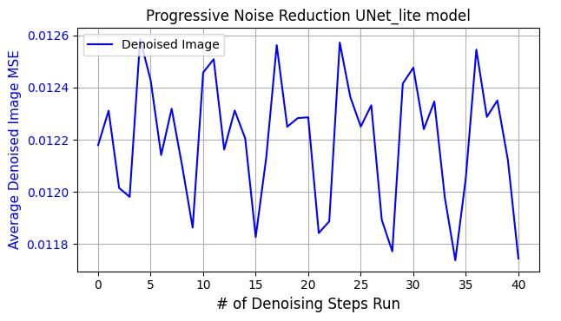
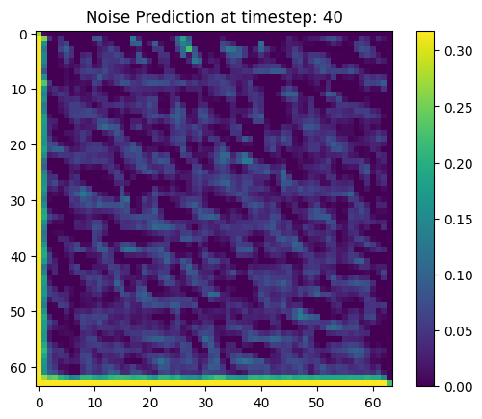
Last week
Getting familiar with UNet model architecture
Over 5x speed increase for training and inference on GPU
Remove pileup with UNet lite model (repeated over large number of events and took average)

Slide 7
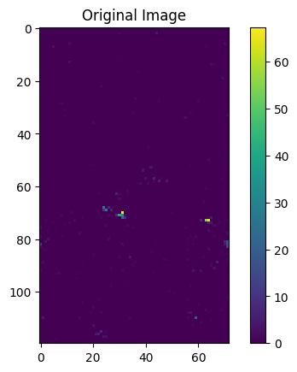
Custom padding
Image fed into model is unwrapped cylinder
Left & Right side of image joined together as phi increases horizontally
Implemented custom padding: circular for sides, constant value for top & bottom

Slide 8
Changes to UNet lite
Increased to number of kernels to 64, heavy computational cost
Applied activation function to noise predictions and denoised images
Fixed connecting paths

Slide 9
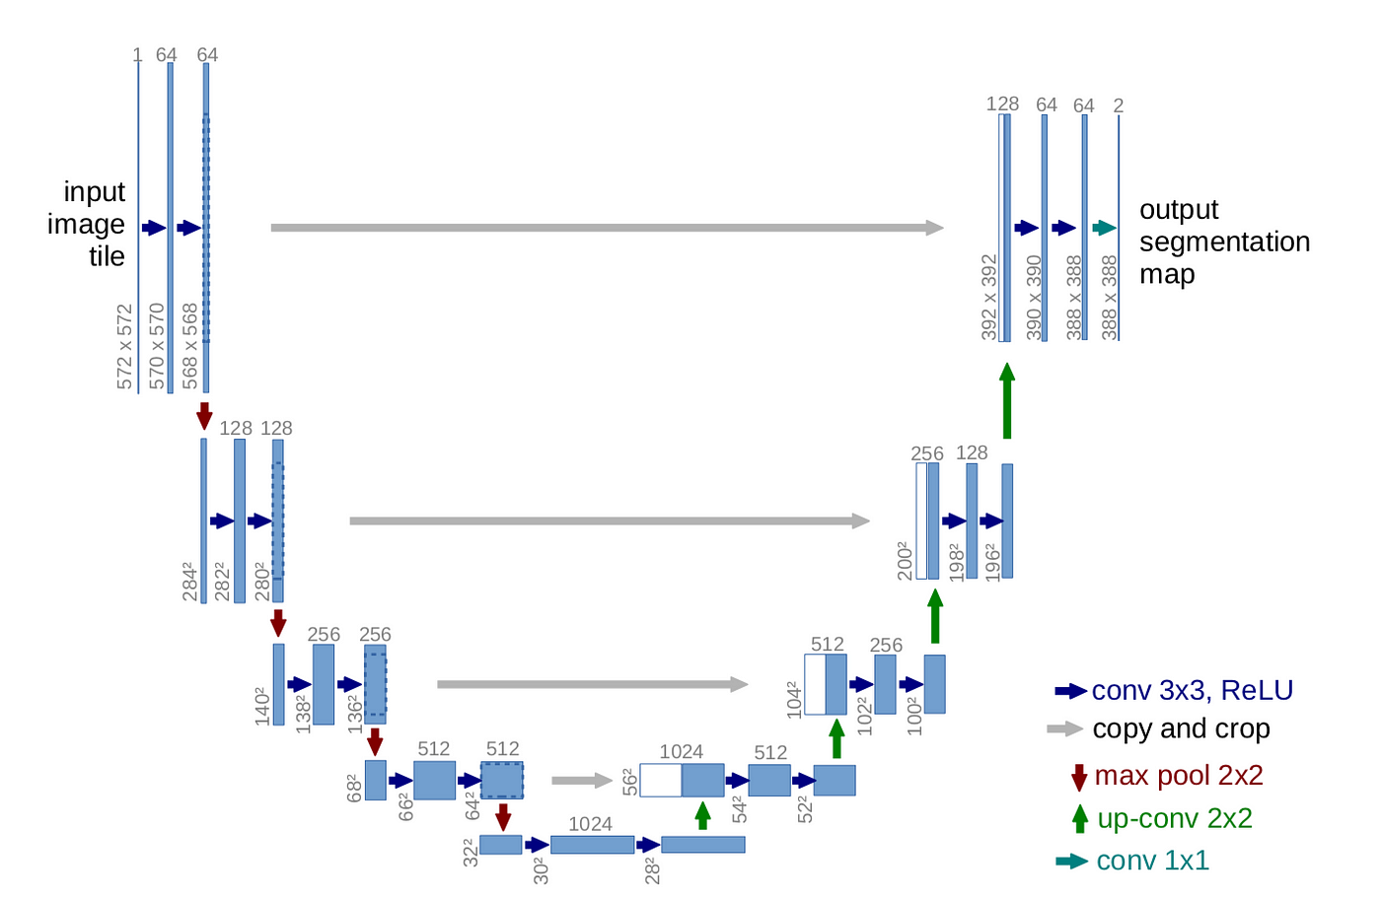
Fixing connecting paths
Block 1
input
Embed temporal & positional info
Convolution 1
Group norm & ReLU
Convolution 2
Group norm & ReLU
Pooling

Slide 10
Fixing connecting paths
Block 1
input
Embed temporal & positional info
Convolution 1
Group norm & ReLU
Convolution 2
Group norm & ReLU
Block 2
Pooling on Block 1

Slide 11
Attention Mechanism
Allows the model to focus on different parts of the input when making predictions
Helps network weigh the importance of different features dynamically
Implemented in the bottleneck

Slide 12
Changing downsampling & upsampling
Model currently used MaxPool2d for downsampling
Nearest method of upsampling
Implemented convolutional method for downsampling
Deconvolution for upsampling
Should also include activation and group normalisation on output after these convolutions

Slide 13
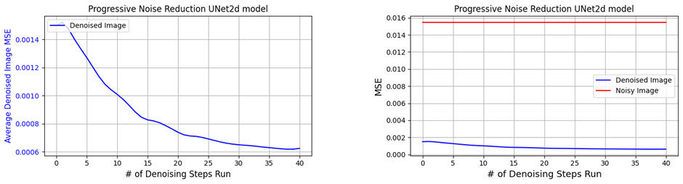
Retrained Unet2d Model Performance

Slide 14
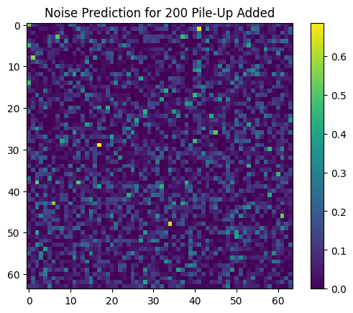
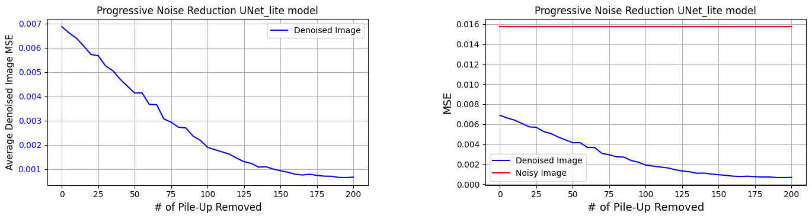
Full Unet lite model
Noise prediction more sensible:
MSE = 0.0006756703223800287

Slide 15
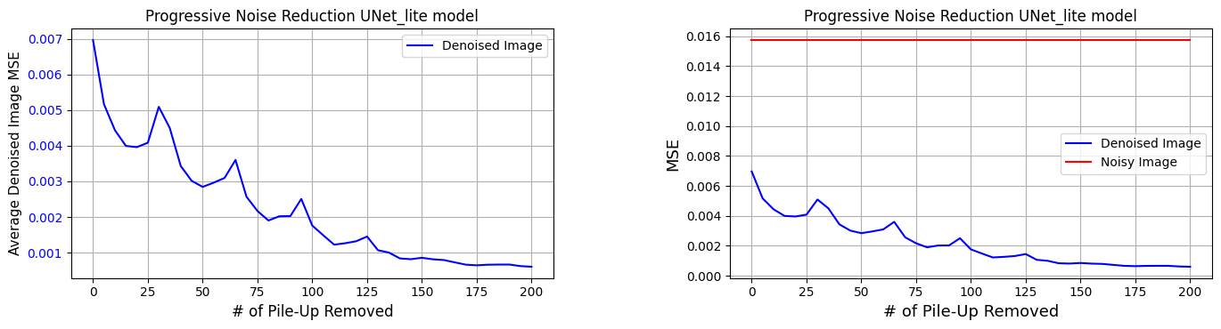
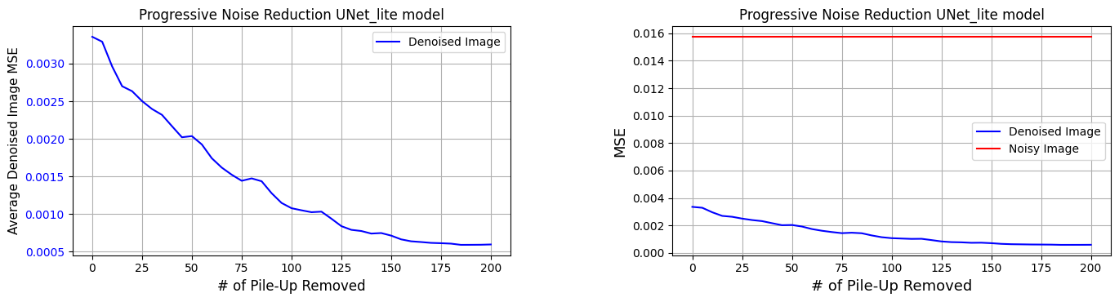
Full
Removing attention mechanism:
Removing 1 down and up block:

Slide 16
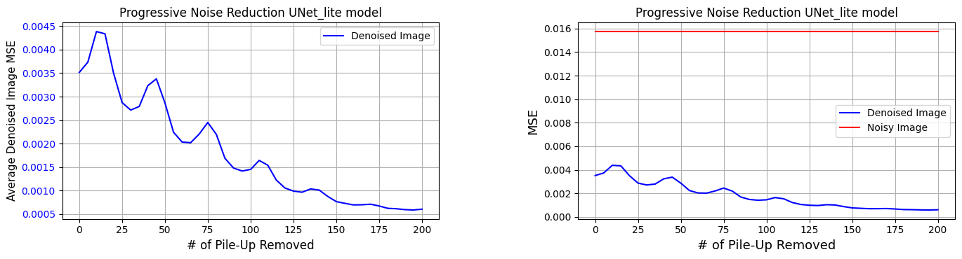
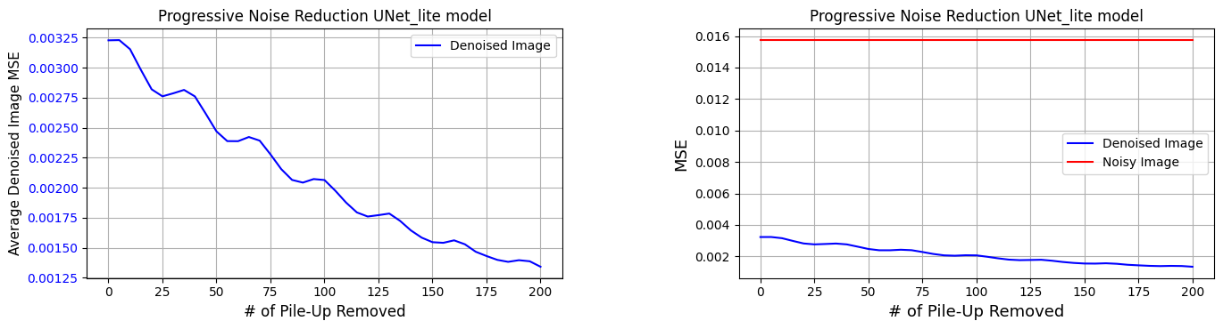
FULL
Max pooling, nearest upsampling (not conv):
Only 16 kernels (much faster)
MSE = 0.0013414

Slide 17
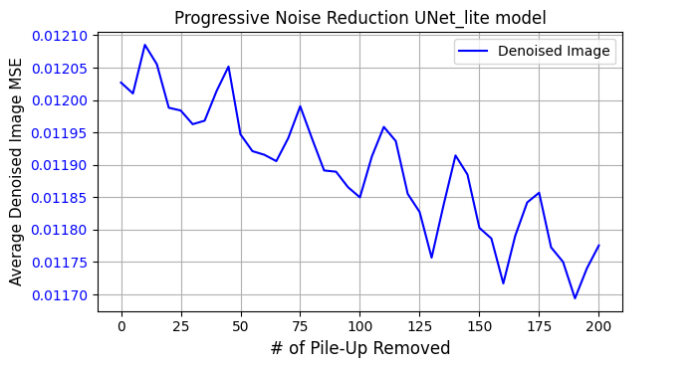
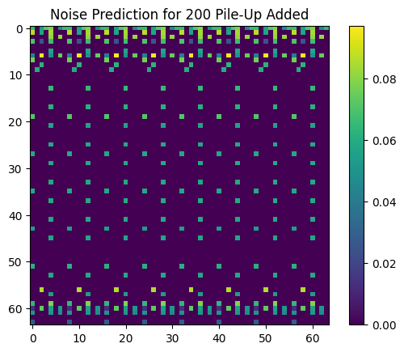
Full
No concatenation/ connecting paths:
MSE = 0.01177

Slide 18
Denoising Pile-Up With Stable Diffusion Week 3
27/06/2024
Luke Johnson

Slide 19
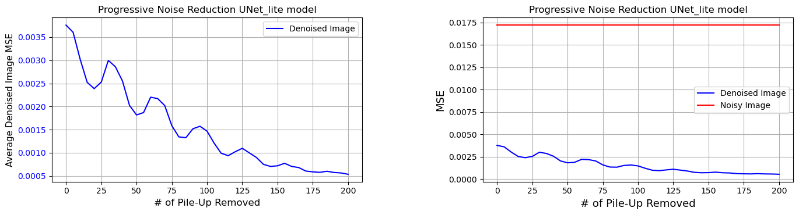
Last week
Introduced custom padding: circular padding for LHS & RHS, constant padding top and bottom
Fixed the connecting paths across UNet model
Fixed ordering of up sampling and concatenation
Increased number of kernels to 64 in each convolutional layer
Applied manual activation to noise pred and denoised images
Introduced an attention mechanism in bottleneck
Changed MaxPooling down sampling → Convolution with stride of 2
Changed ‘nearest’ up sampling → Deconvolutional up sampling
FULL UNet-lite:
Attention mechanism removed:

Slide 20
Changing Training and Testing data
Modified data_processing.py to take in start and end indexes for events to be loaded
Can now load custom indexes of events
If no arguments given, defaults to loading the first e.g. 10,000 events

Slide 21
Running Locally
Managed to get the data and files onto my local machine
Downloaded cuda drivers
Can now run ~ 2x faster on my personal GPU compared to DICE GPU04
Had to adjust environments on PC

Slide 22
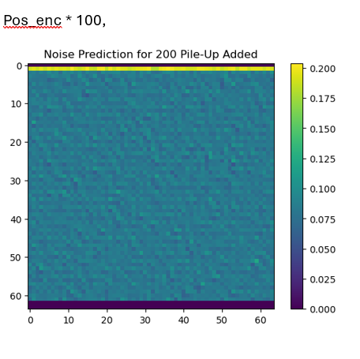
Fixing Oscillations
Hypothesised that occurs from positional encoding
Overlays sin and cos functions onto the noised images with a specific frequency
Model can read this and determine where in the denoising process it is
If amplitude to big, can overpower the signal image
If amplitude too small, model doesn’t know where in denoising process it is
Aside: Changed to replicate padding to avoid this:

Slide 23
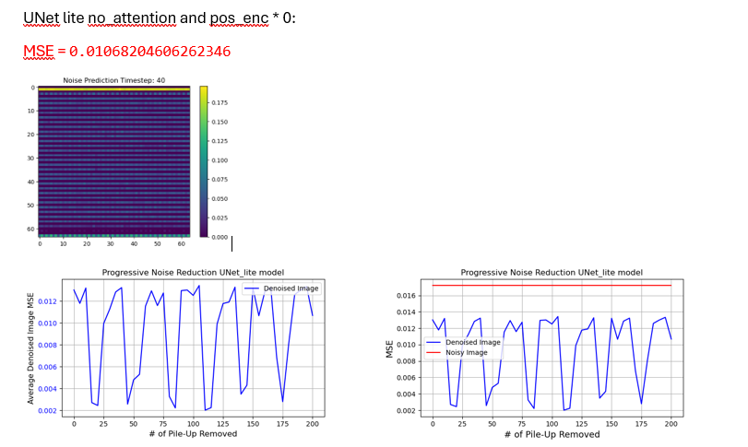
No encoding

Slide 24
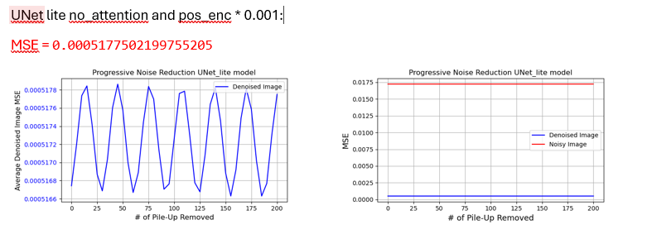
Amplitude Too Small

Slide 25
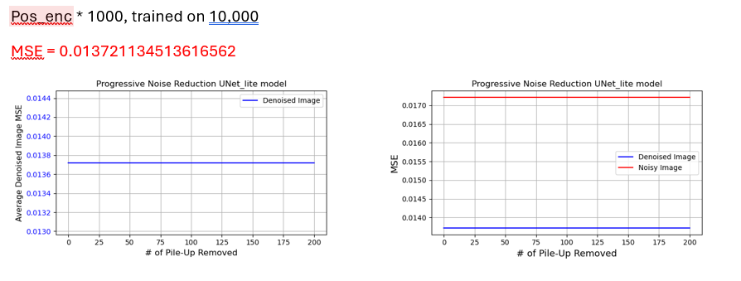
Amplitude Too Big

Slide 26
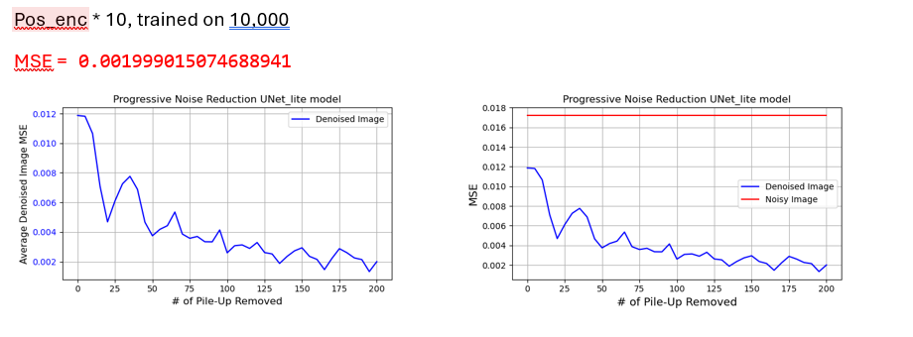
Scalars > 1
Initial MSE closer to noised image MSE

Slide 27
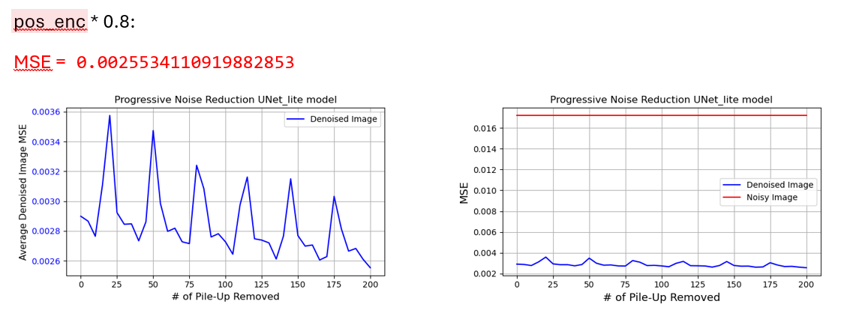
Scalars < 1
Flatter average gradient
Initial MSE further from noisy image MSE

Slide 28
UNet2d Model, Retrained
Number of learnable parameters = 1,566,209
MSE = 0.0004756

Slide 29
FULL UNet-lite Model
Number of learnable parameters = 655,222
MSE = 0.00069095

Slide 30
Stripping UNet-lite
Removed: Attention mech, convolutional pooling & up sampling, 1 up & 1down block
Number of learnable parameters = 595,142
Further removed the number of kernels from 64 to 16 BUT reintroduced deconvolutional up sampling and convolutional down sampling (this only added 2,000 params)
learnable params = 29, 652 ← very close to what can be implemented on a FPGA

Slide 31
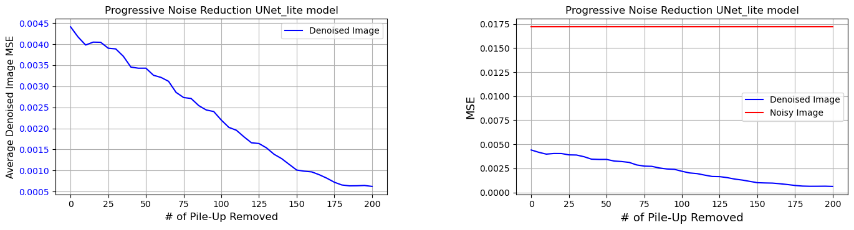
UNet-lite (that is actually lite!!)
Pos_enc * 0.87 found to sometimes give the lowest oscillations, sometimes get lucky with the training
learnable params = 29, 652
MSE = 0.0006228831821742157

Slide 32
Denoising Pile-Up With Stable Diffusion Week 4
04/07/2024
Luke Johnson

Slide 33
Last week
Modified data_processing.py to take in start and end indexes for events to be loaded. Can now load custom indexes of events
Managed to get the data and files onto my local machine ~ 2x faster compared to DICE GPU04
Tried to fix oscillations potentially from positional encoding
Stripped UNet-lite
Removed:
Attention mechanism
1 up & 1 down block
Number of kernels from 64 to 16
learnable params = 29, 652 ← very close to what can be implemented on a FPGA
UNet-lite Attention mechanism removed :
UNet-lite:
Learnable parameters reduced 655,222 -> 29,652
(With no notable change in MSE)

Slide 34
Saturation Energy
Saturation in a calorimeter occurs when the energy deposited by a particle exceeds the maximum energy that the calorimeter can accurately measure
Particles deposit large variety of energies
Calorimeters have a finite dynamic range. If the energy deposited exceeds this range, the readout electronics cannot accurately measure it, leading to saturation.
Saturation too high: dynamic range stretched, reduces sensitivity for lower energies
Saturation too low: Image full of maximum values

Slide 35
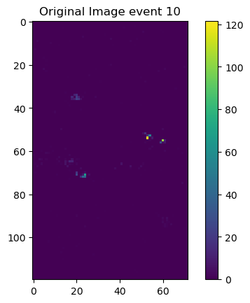
Fixing Saturation Energy
What script was doing was clipping & scaling the signal and noise images between 0 and saturation value independently then adding them together.
This means that the noised image could have bins up to values of 2
The ordering of resizing and rescaling these images was also wrong

Slide 36
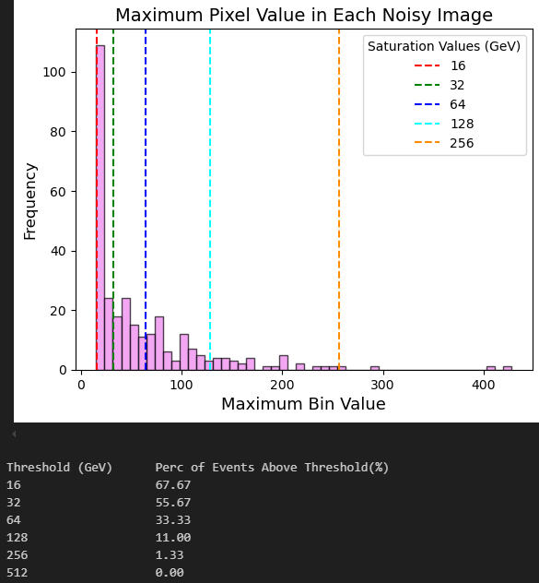
Choosing Saturation Value
Plotted histogram of resized images without any clipping to get an idea of good value to choose as saturation energy (avoid clipping ~99% of events)
Chose 512 GeV for now
Now my code:
Only resizes the bins in data_processing.py (no scaling)
Adds noise to signal event with raw data
Applies torch.clamp(noisy_image, max=saturation_value)

Slide 37
Slicing up Detector
Currently the models are fed the entire detector image during training and inference
In reality, each FPGA might only see a slice of the detector, stitched together later
Took a horizontal slice of image (phi), central 12 pixels thickness
Had to adjust all the reshaping code
Can now train and run inference for a model which can only see the slice

Slide 38
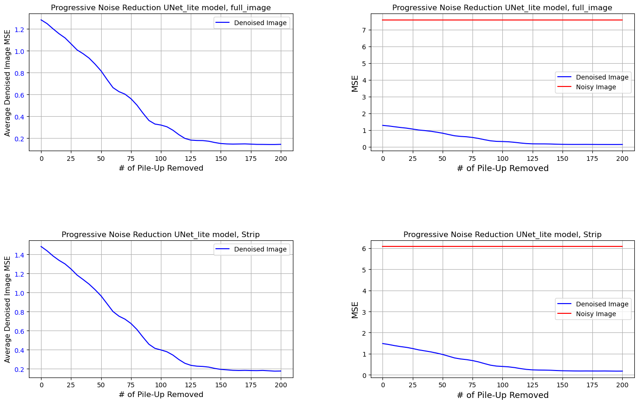
Slicing up Detector
If you want to use model that can see the entire image, additional MSE calculations implemented to show the MSE of the strip
The avg MSE for the strip (y=26 -> y=38) across 300 events is: 0.22550240551431974
The avg MSE for the full_image across 300 events is: 0.3037728042900562

Slide 39
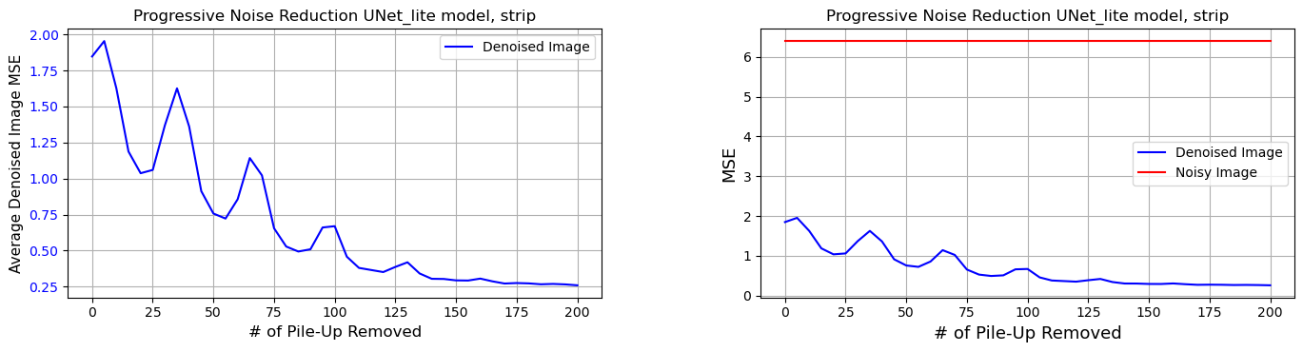
Slicing up Detector
The avg MSE for the strip across 300 events is: 0.259129676943024

Slide 40
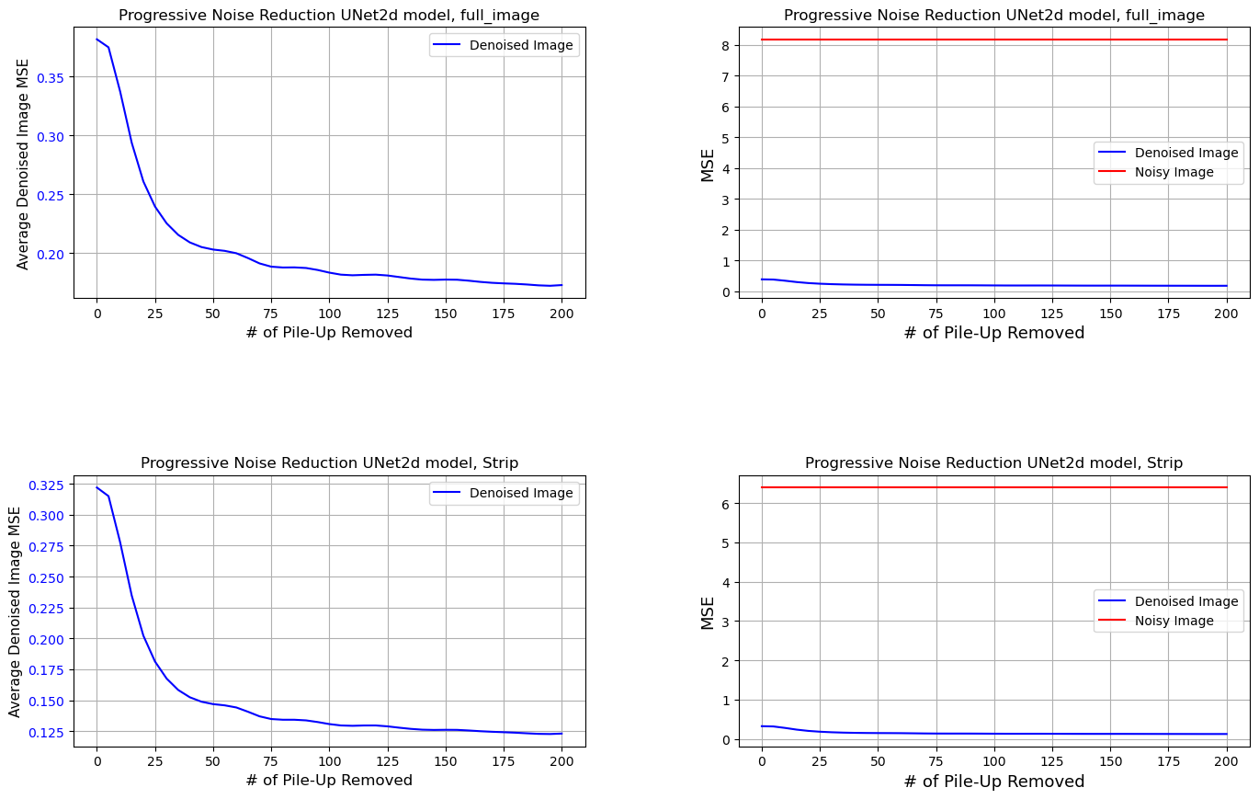
Slicing up Detector
The avg MSE for the strip (y=26 -> y=38) across 300 events is: 0.1230276533953535
The avg MSE for the full_image across 300 events is: 0.1728174258520206

Slide 41
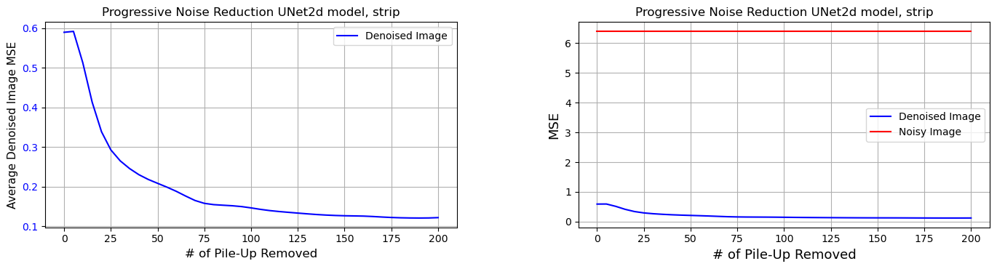
Slicing up Detector
The avg MSE for the strip across 300 events is: 0.1214534561910356

Slide 42
Jet Finding
Went through jet_clustering.py and made changes to the initial code setup so it worked with the changes made similarly in inference and training notebooks. For example:
Adding start & end indexes to the dataset
Saturation value implementation
Moving model and device all to GPU
Implemented the ability to select a ‘strip’ of the detector
Etc.

Slide 43
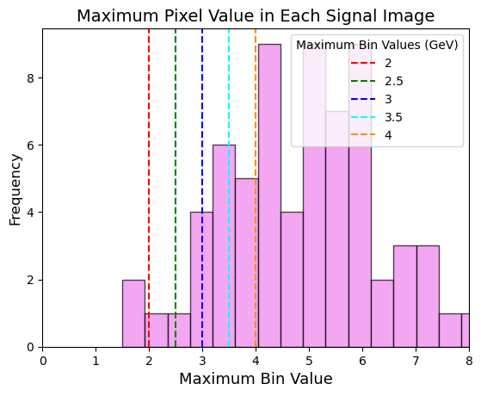
Jet selection
To get an idea of the order of magnitude of a jet in each event, plotted histogram of maximum bin value for each clean/signal event

Slide 44
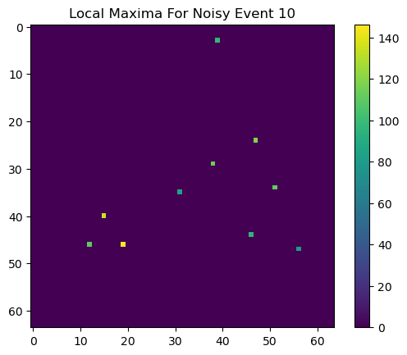
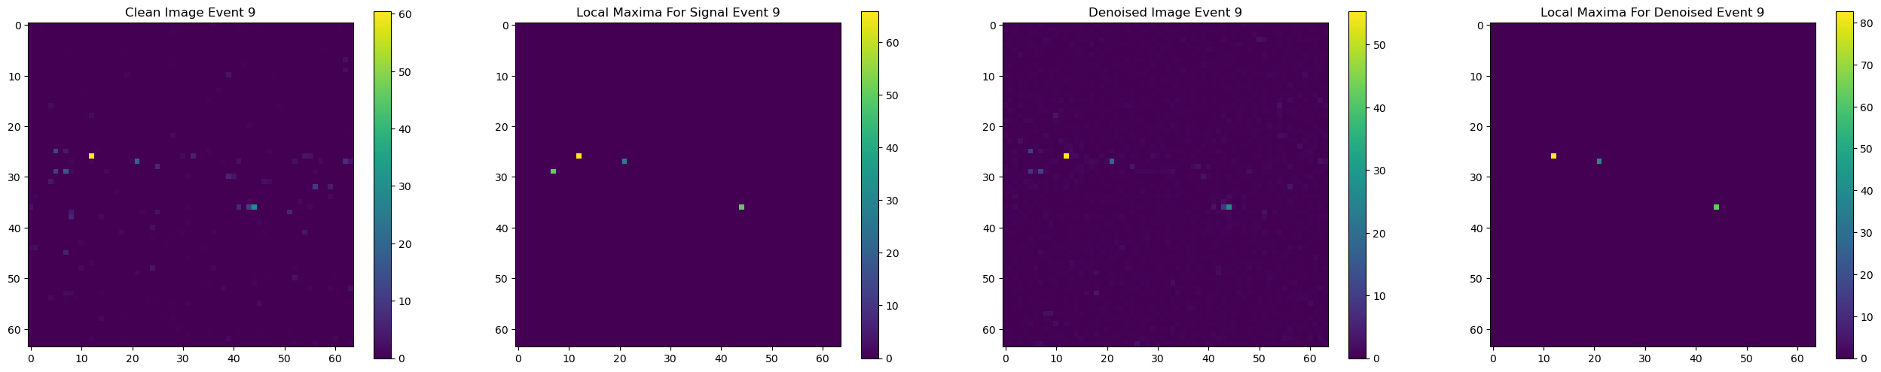
Jet_clustering.ipynb

Slide 45
Changing Method of Finding Local Maxima
The way the local maxima was being found was:
Checking if each pixel was the brightest in the 9x9 surround grid
If pixel was above a threshold value
I implemented new checking function which accounted for unwrapped cylinder
Input images no longer normalised -> new threshold calculation
Pixel must be greater than 50% of the brightness of the 2nd brightest pixel that did not fall in a 3x3 grid surrounding the brightest pixel

Slide 46
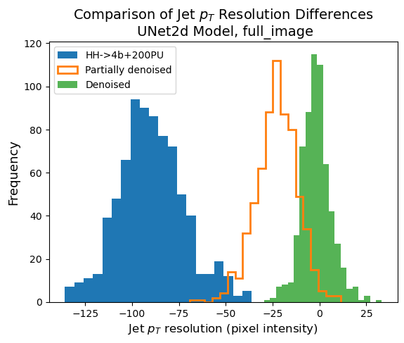
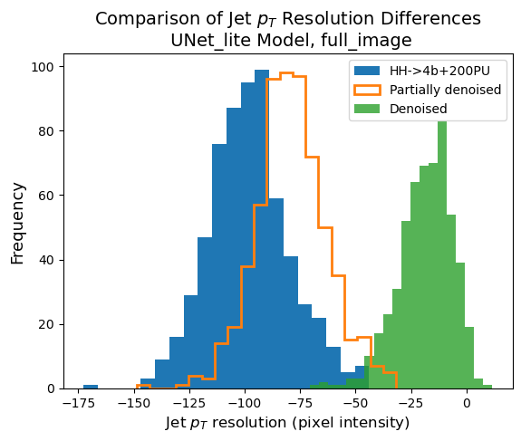
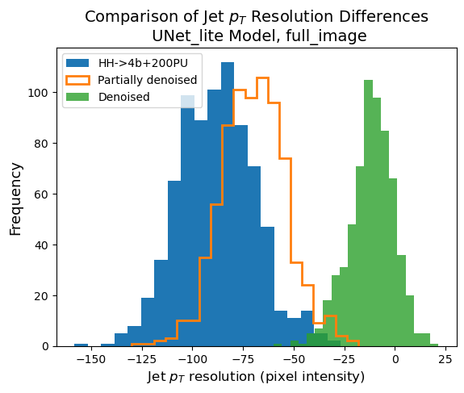
threshold = 0.6 * 2nd highest pixel value
threshold = 0.5 * 2nd highest pixel value only if outside 3x3 of brightest

Slide 47
Denoising Pile-Up With Stable Diffusion Week 5
11/07/2024
Luke Johnson

Slide 48
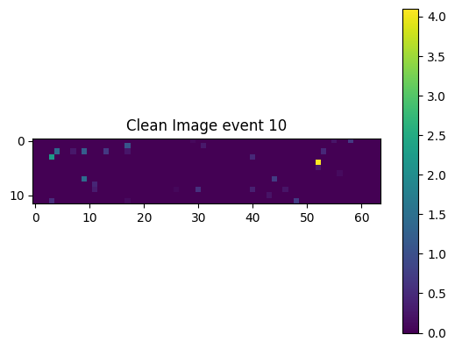
Last week
Fixed saturation energy implementation
Before was rescaling and clipping signal and noise before adding together as well as rescaling before resizing
FPGA might only see a slice of the detector, stitched together later
Can now train and run inference for a model which can only see the slice
Changed jet finding algorithm to find jet maxima
Calculated difference in sum around maxima between denoised image and clean image
Choosing saturation values:

Slide 49
Image normalisation
Currently images being fed into model are raw energies
Machine learning models work better with normalised inputs
Problem with norm( signal ) + norm( noise ) is high energy events lose their scale compared to the noise
E.g. 170 GeV event + 200PU should make less difference than 5 GeV event + 200PU
Problem with norm( signal + noise ) is for high energy events noise values will be pushed to 0 (model might try removing too much noise)

Slide 50
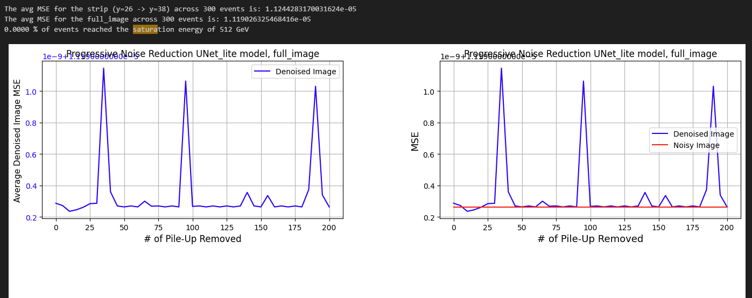
Global Normalisation
Noisy_image/sat_val & noise_added/sat_val during training and clean_image/sat_val for MSE calc

Slide 51
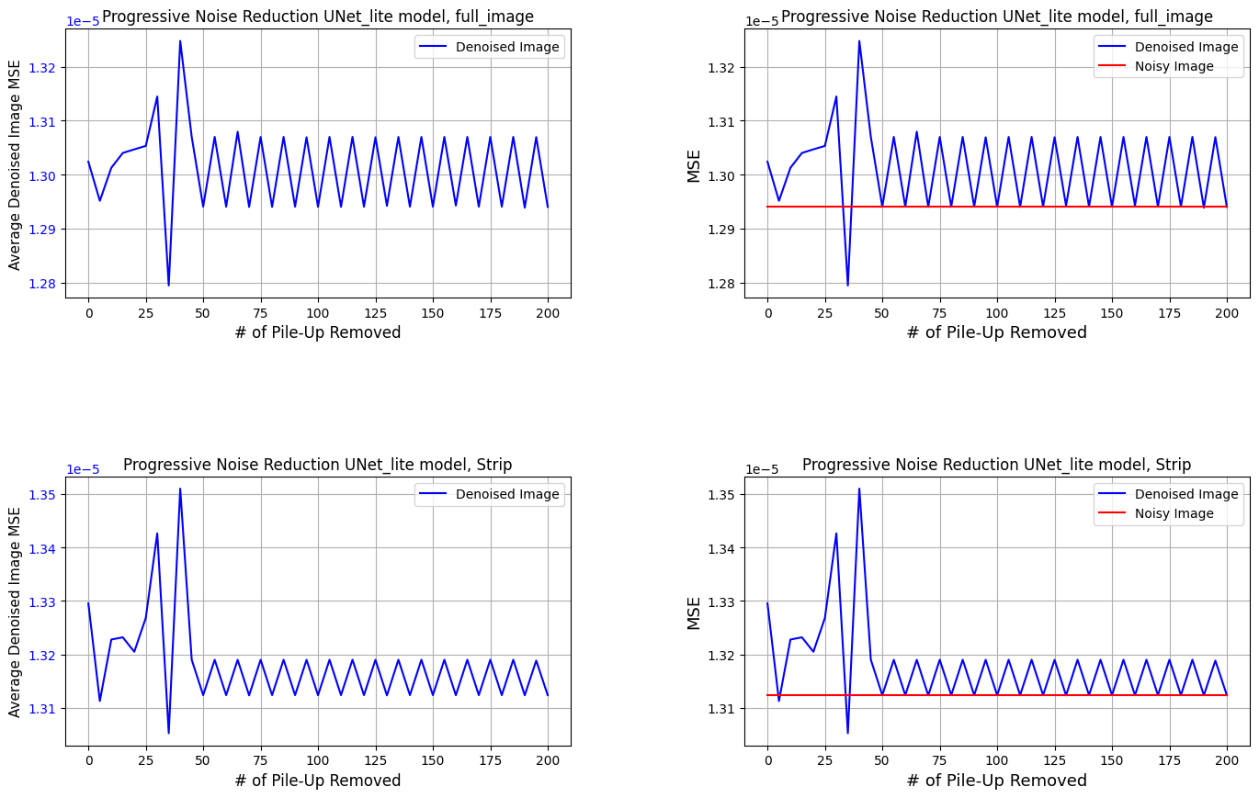
Global Normalisation
Different method: dividing all signal & pileup data by saturation value

Slide 52
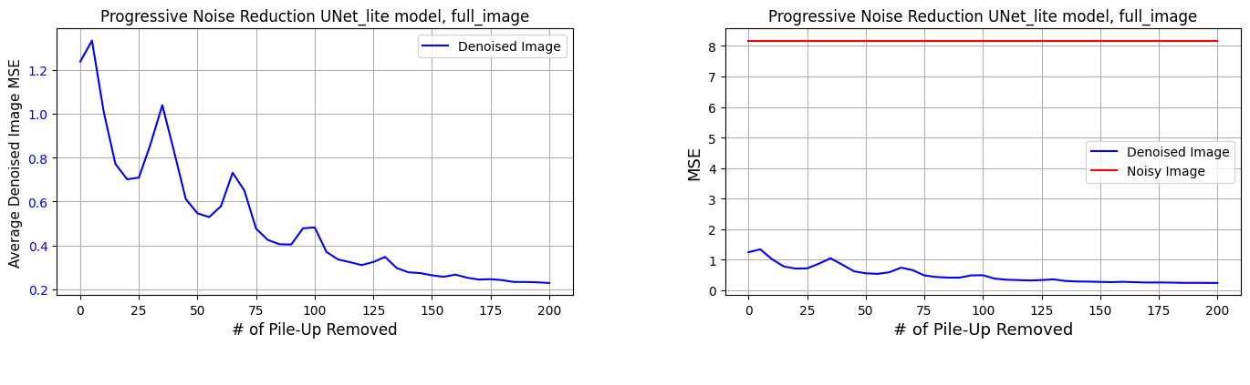
Loss Functions
Varied loss function
Current loss function: MSE between noise prediction and noise added
The avg MSE for the full_image across 300 events is: 0.2286065053070585
Potentially better to use MSE between denoised images and clean images. More in line with end goal of minimising this

Slide 53
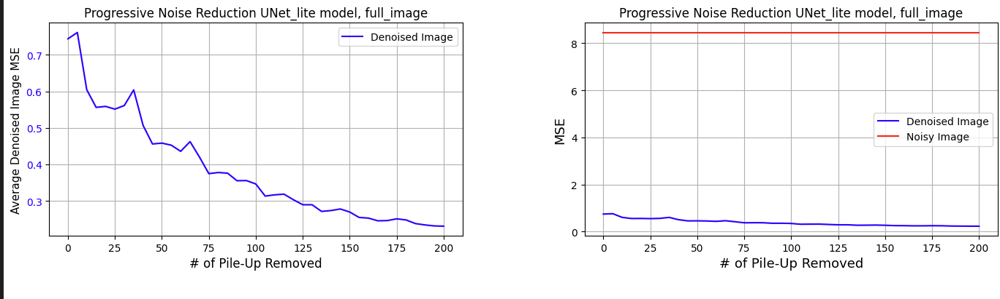
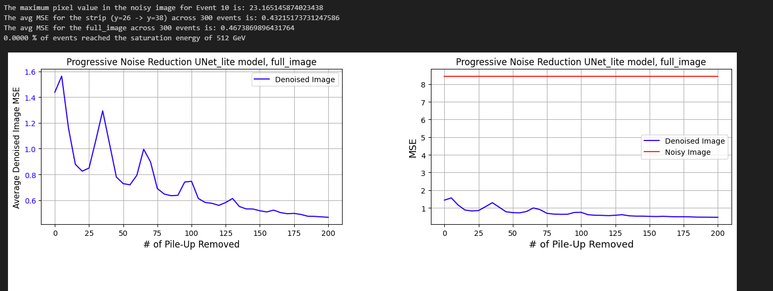

Loss func = MSE between Denoised & clean images
Inference MSE = 0.23055
Loss func = MAPE between denoised & clean images
Inference MSE = 0.46739
Loss func = MAPE & MSE hybrid between denoised & clean images (alpha = 0.5)
Inference MSE = 0.46582

Slide 54
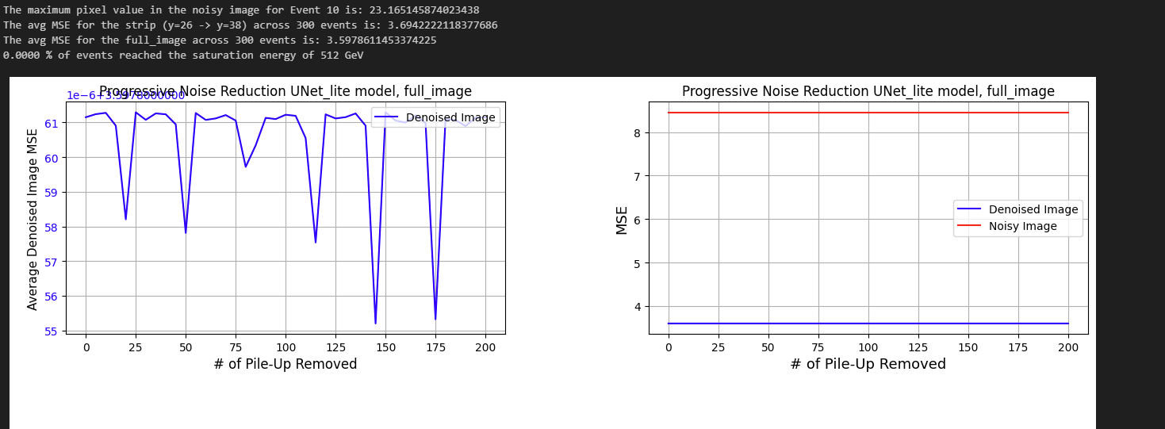
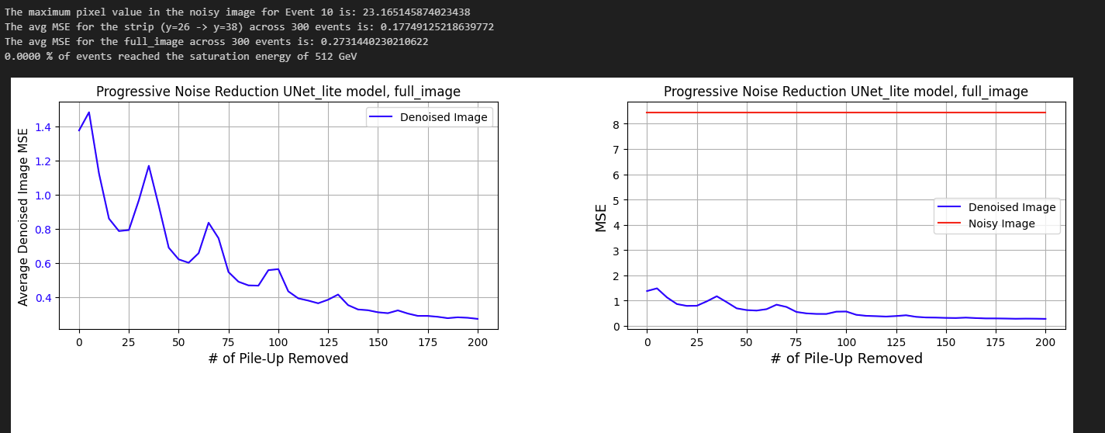
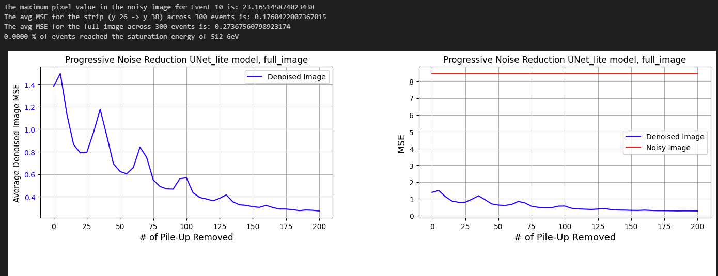
Loss func = MAPE between noise pred & noise added
Inference MSE = 3.59786
Loss func = Hybrid of noise pred & noise added MSE and denoised & clean image MSE (alpha = 0.5)
Inference MSE = 0.27314
Loss func = Hybrid of noise pred & noise added MSE and denoised & clean image %MSE (alpha = 0.5)
Inference MSE = 0.27368

Slide 55
Loading Dataset Once
Currently every time run notebooks, the entire .root files are loaded and converted to numpy
Fixed save function in data_processing.py to save the signal and pileup numpy tensors to numpy file
Loaded all 100,000 events and saved to numpy files
Tries to find numpy files, if found then assigns custom indexed events to arrays
If no numpy file then proceeds with loading .root files like before
Dataset now loads in 2.2s instead of 40s

Slide 56
Image Batching
The dimensions of all images should be (batch_size, channels, height, width)
E.g. for 500 events: (500, 1, 64, 64)
Before the images were being generated 1 by 1, having noise added and fed to model all in a loop
If feed batch of images in one go to noise.py & model then speed up program

Slide 57
Noise.py With Batches
Responsible for adding noise to signal image
add_pile_up_noise function was adding the same noise pattern to each image in batch before
Now for each image in the batch a noise sample is selected from noise_sample using random seed
Each image receives a unique combination of noise samples

Slide 58
Inference.ipynb With Batches
Changed inference notebook to now deal with batches and new image dimensions of (B,C,H,W)
Denoising done for whole batch rather than loops
In last cell, for each timestep value program denoises batch of images
Previously for each event, program would loop over each timestep and remove that amount of noise
For 300 events, 40 different timesteps = 12,000 denoising steps:
Without batches: 45s
With batch size = 100: 14.3s

Slide 59
Jet_finding.py With Batches
This file has functions responsible for finding jets & local maxima in input images
Modified so can pass in a batch of images and find local maxima simultaneously
Checks for local maxima for each pixel for whole batch at once.
For 300x64x64 images, 4096 iterations (reduced from 1,228,800)
For 300 events, finding maxima takes 2s instead of 25s
Jet_rate code added to end of jet_clustering notebook

Slide 60
Fixing Model
In Unet_lite lots of the convolutional layers are identical
Normalisation, pooling, up sampling operations also all identical as consistent channels throughout model
CANNOT reuse variable names in PyTorch
Replacing all convolution layers with single variable and call this variable in multiple places during forward pass will override the weights
Explicitly called different variable for every normalisation, pooling, up sampling, convolution for each instance in each block

Slide 61
Custom GPU
Added ability customise the GPU used in notebook
Can copy and paste training notebook and run on different GPUs
For Unet2d, max batch size ~100 events when running notebooks for GPU memory limit
UNet2d final avg MSE = 0.1590442242349188

Slide 62
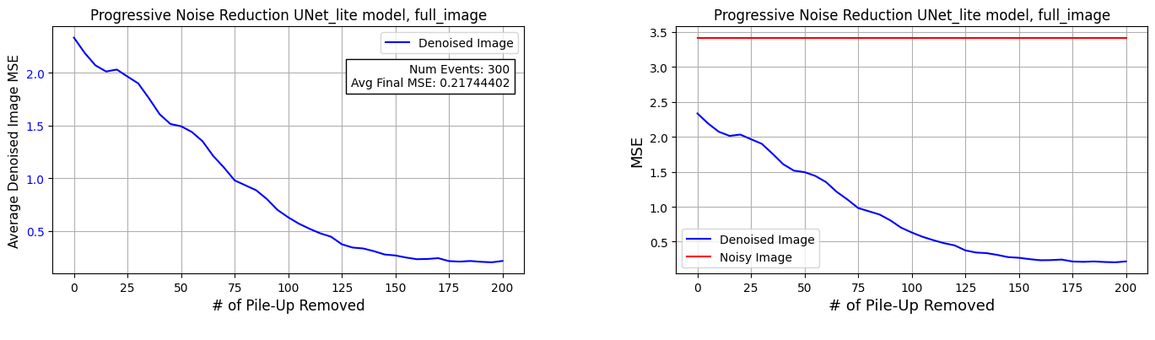


16 Kernels throughout Params = 32,000

Slide 63


Doubling kernels down each block
Kernels = 8->16->32
Params = 32,000

Slide 64

Kernels = 4->8->16
Params = 8,400

Slide 65
Denoising Pile-Up With Stable Diffusion Week 6
18/07/2024
Luke Johnson

Slide 66
Last week
Model did not learn when using normalised inputs (/saturation_value)
Evaluated different loss functions (MAPE, %MSE, denoised & clean vs noise_pred & noise_added)
data_processing.py
Bug fixes save correct signal and pileup data to .npy
Checks for numpy files before loading root
Dataset now loads in 2.2s instead of 40s
noise.py
was adding the same noise pattern to each image in batch
Batching
Inference, noising, jetfinding all handle batches of images at once (no denoising loops). 4-12x speed increase

Slide 67
Last week
models.py
Fixed bug where had to explicitly define and call different versions of identical layers to avoid overwriting weights in PyTorch
Implemented custom GPU selection -> Can now train different models on different GPUs
Ran jet finding algorithms on different sized Unet lite models

Slide 68
Conversion to Keras
Had to change all files (training, model, inference etc.) to work with Keras instead of PyTorch
Setup environment (took a long time find compatible packages)
Used tensorflow-gpu == 2.11.0
To allow GPU training
To include learning rate cosine decay scheduler & other training features

Slide 69
Changes
Rewrote Model in Keras
Defined classes for attention mech, custom padding, pos/temporal encoding
All dimensions across files are now (batch_size, height, width, channels)
Thought about changing training so each image within batch received different timestep value for noise (decided against)
Used tensor flow function decorators to transform python function to TensorFlow graph
Operations in the graph are executed more efficiently
Automatic GPU detection
Performance optimisations
Had to fix retracing in training loop (defined outside loop, constant input shapes, passing tensor objects)
Experimented with mixed precision as DICE GPUs are optimised for these calculations

Slide 70


Oscillations – Solved!
Model trained by adding N steps of noise then removing N steps of noise
N varies, loss function evaluated each time This is why the corresponding graph at bottom of page is good (no oscillations)
This N is passed to the model and the model thinks there is N steps added from the positional/ temporal encoding
In the final MSE graph we were adding 40 steps of noise then asking the model to remove N -> different task
This N is passed to the model, model now think only N steps of noise have been added to image (instead of 40) so it thinks it is removing all the noise from the image, weird stuff happens. Tries to remove too much noise & doesn’t know image has 40 timesteps of PU
This is why the oscillations get smaller towards the end of the graph, N tends to 40. The model is very good at removing 200 PU from noisy image with 200PU, almost as good at removing 175 PU from 200 PU image, rubbish at removing 50PU from 200 PU image

Slide 71
Can We Change Training?
Can’t really fix
If ask model to remove 5 PU from 200PU image, which 5 PU should it remove and compare loss function to?

Slide 72



Keras - Results
Full model
# kernels = 128 throughout
Attention block
#params = 3,322,886
Reduced
# kernels = 8 throughout
No attention block
Doubling kernels
# kernels = 4,8,4 (d,b,u)
No attention block
1 down, bottleneck, 1 up block
1down, bottleneck, 1 up block
Trained on 5 epochs (not 9)
Trained on 9 epochs
Trained on 9 epochs
#params = 4,950
#params = 2,062

Slide 73
Next steps
Synthesise model with HLS4ML

Slide 74
Denoising Pile-Up With Stable Diffusion Week 7
25/07/2024
Luke Johnson

Slide 75

Last week
Changed all files and notebooks to work with Keras model instead of PyTorch
Setup the environment for training and inference with Keras model
Added a .gitignore to prevent committing .npy files
Understood WHY the oscillations were being seen in the final MSE graph
Created 3 models with a good variety of size & performance

Slide 76

DICE NOT WORKING
Unfortunately, gpu04 stopped working during DICE upgrades -> could not connect to node
Then power works on server room meant could not use DICE at all
Tried to work locally on personal rig

Slide 77

Personal Setup
Difficulty getting tensorflow-gpu to work and other libraries on windows PC
For example tensor-flow ended windows gpu support in 2019 around version 2.0.0
Downloaded WSL2 Ubuntu version 2 to run a genuine Linux kernel inside a lightweight virtual machine
Ran commands to get CUDA installation for WSL2
Also got the WSL extension in VScode
Installed Miniconda in Ubuntu environment and setup environments
Stored all project files in WSL2 filesystem as encounter issues if use windows fs and mount to C: drive to find project files

Slide 78
Setting Up Vitis HLS
Installed Vitis in WSL2 fs using the Linux installer
In the hls_converter script set the correct PATH and LD_LIBRARY_PATH environment variables to include Vitis_HLS
Verified Vitis_HLS installation
hls_converter script requires Keras model weights & architecture in .h5 file (current script only saves weights then loads into python model)
Worked on changing and so training script saves both weights & architecture

Slide 79
Denoising Pile-Up With Stable Diffusion Week 8
01/08/2024
Luke Johnson

Slide 80
Model Compatible with hls4ml
hls4ml converter had issues converting models that were defined using custom classes
Converter supports models built using sequential API or functional API of TensorFlow/ Keras
Original Keras models were defined with subclassing API, rewrote in a function-based approach to ensure compatibility with hl4ml
Defined model architecture within a function that creates & returns a Keras model
model_for_hls.py file also has a function to precompute positional encoding

Slide 81
Handling Unsupported Layers
Problem | Fix
Unsupported subclassing API in hls4ml | Redefined Keras model with functional API
hls4ml unsupported layer normalisation | Replaced with batch normalisation
Unsupported TFOpLambda layers: custom tf.<operations> aren’t supported by hls4ml (e.g. tf.shape) | Ensured layers were all standard Keras layers. Passed in batch size as an argument when fetching model to perform any reshaping.
Conv2D transpose upsampling unsupported by hls4ml | Replaced with upsampling2D (‘nearest’ method) followed by conv2D layer
Custom positional encoding layer unsupported. Can’t use custom tensorflow operations directly in model. | Introduced pos_enc function in the model file to precompute encoding values and then pass these as additional inputs when calling the model

Slide 82
Changes to training.ipynb
Note that the timestep is no longer an input to the model
Positional encoding takes timestep as an input. Model takes:
inputs = [images, pos_enc, pos_enc_bottleneck]
When fetching model, batch size is an argument

Slide 83
Setting Up Paths and Shell Script
Had to create a run_hls.sh script because the system couldn’t find and use the Vivado HLS tools and libraries without
The script sets up the necessary environment variables and sets the PATH & LD_LIBRARY_PATH environment variables for Vivado HLS 2019.2 and sources the Vivado settings script (settings64.sh)
Encountered an error indicating the libridi_commontaks.so (contains common tasks/ functionalities required by Vitis HLS tools during synthesis) could not load due to missing libtinfo.so.5 library (used for terminal handling: controlling terminal input & output)
My system had libtinfo.so.6 installed as part of the ncurses package. Solved by using symbolic link from libtinfo.so.5 to libtinfo.so.6

Slide 84
Creating Plotting Code
Now use ./run_hls.sh to run hls converter script
hls4ml.model.profiling required adding pandas and seaborn to the environment (also added all other libraries required for hls conversion)
In the main() function, setup the data loading and noise generative code
layer_plots() function generates & saves scatter plots and histograms for each layer to compare hls & Keras model outputs
More code of weight and activation distribution box plots using ‘numerical’ function from hls4ml
The HLS model has some extra layers ending in ‘_linear’ which are ignored when generating plots

Slide 85
Inference With HLS Model
Had to add executable permissions to the build_lib.sh script (which compiles and links C++project)
Inference notebook changed to work with the keras model & hls model
Both the hls & Keras model take in the same arguments butmust ensure that all inputs are converted to numy arrays first
Hls model returns a flattened image which needs to be reshaped

Slide 86




Slide 87





Slide 88
Cleaning Up Repo
Created a new README which includes an updated recipe and ideas on where to get started for next student
Added markdown at top of notebooks in the Keras version folder explaining variables that might need changing for new user’s setup
Added these slides to the repo

Slide 89
Denoising Pile-Up With Stable Diffusion Week 9+
03/08/2024
The following slides were made AFTER the final trigger meeting to show any further changes.
Luke Johnson

Slide 90
Fixing HLS4ML ‘numerical()’ Func
Getting an error when trying to create box plots of weights and activations
Inhomogeneous shape of inputs after dimension 1:
In the `profiling.py` script in hls4ml source code, the `numerical()` function calls another function called `activations_hls_model()`which performs a trace with `_, trace = model.trace(np.ascontiguousarray(X))`
I changed this to `_, trace = model.trace(X)`which fixed the problem
Ensure that `X` takes the correct form of inputs to your Keras model where each input is a numpy array NOT tensor
Model Input | Shape
noisy_images | 100, 64, 64, 1
pos_encoding | 100, 64, 64, 4
pos_encoding_bottleneck | 100, 32, 32, 4

Slide 91




Slide 92






Slide 93

The proceeding slides used the following fixed precisions

Slide 94


Latency and Resource Usage
Parameter | Config
Io type | io_stream
Packing factor | 1
Clock frequency (MHz) | 360
Parallelisation factor | 1
Reuse factor | 1
Pipelining | False
We are aiming for 1 microsecond of latency

Slide 95


Changing Config
Parameter | Config
Io type | io_stream
Packing factor | 1
Clock frequency (MHz) | 800
Parallelisation factor | 4
Reuse factor | 1
Pipelining (conv & emb layers) | True
Increasing clock frequency lowered latency, the other values had little effect.

Slide 96


Changing Image size from 64x64 -> 12X64
Parameter | Config
Io type | io_stream
Packing factor | 1
Clock frequency (MHz) | 360
Parallelisation factor | 1
Reuse factor | 1
Pipelining (conv & emb layers) | True
Drastic decrease in latency. However, pixels are still being processed one at a time

Slide 97


Using Packing factor (still smaller image)
Parameter | Config
Io type | io_stream
Packing factor | 8
Clock frequency (MHz) | 360
Parallelisation factor | 1
Reuse factor | 1
Pipelining (conv & emb layers) | True
8 data elements grouped into 1 data word.
Allows design to process multiple data elements simultaneously per clock cycle.

Slide 98


Using Packing factor (still smaller image)
Parameter | Config
Io type | io_stream
Packing factor | 128
Clock frequency (MHz) | 360
Parallelisation factor | 128
Reuse factor | 1
Pipelining (conv & emb layers) | True

Slide 99


Using Packing factor (still smaller image)
Parameter | Config
Io type | io_stream
Packing factor | 1
Clock frequency (MHz) | 360
Parallelisation factor | 16
Reuse factor | 1
Pipelining (conv & emb layers) | ‘flatten’

Slide 100
Potential Latency Bottlenecks
Pipelining:
Overall pipelining strategy for top-level design is `dataflow`
This is used to overlap the execution of different functions/ data-processing stages in the design allowing them to operate simultaneously
Pipelining allows new data to enter pipeline before previous data has finished processing
In the detail instance section of the csynth report where each layer/module is listed, the operations within each layer (e.g. within a conv layer) seem to execute sequentially
Parallelisation:
Specifies the number of operations that can be performed concurrently within a single loop/ function cycle

Slide 101
Potential Latency Bottlenecks
Loop unrolling:
Duplicates body of loop multiple times to decrease iterations, reduce loop overhead
Can lead to better parallelism
I/O types:
Io_parallel multiple data values processed simultaneously
All pixels are available at once to be processed
Io_stream data processed one piece at a time
Need to significantly reduce image size for io_parallel

